Slide 1
Black-jack
(env)
State : [Dealer_Sum, Player_Sum, Ace_Y/N]
Action(Policy) : Stick(0) or Twist(1) (stick if sum of cards >= 17, otherwise twist)
Reward : Player_win => 1
Draw => 0
Player_loss => -1
게임 순서
Deck 을 섞는다. (52장을 shuffle 한다)
Dealer, Player 에게 패를 배분 (Player 초기 패가 12이하일 경우 더를 더 받는다)
If action == stick
→ Player_sum 확정 후 Dlear_sum계산
(Dealer의 패가 17이하일 경우 패를 계속해서 받는다)
If action == twist
→ Player가 패를 계속 받는다.
(만약 Player_sum > 21 일 경우 패배)
4. 매 episode의 첫 state의 reward를 평균을 업데이트 해준다.(Monte-Carlo)

Slide 2
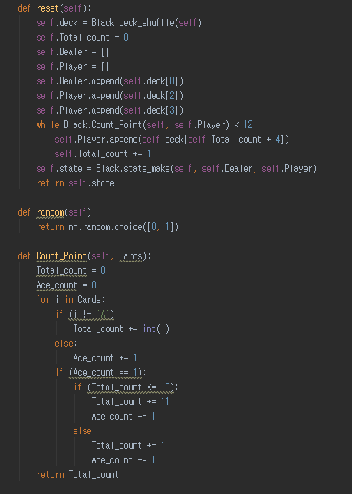
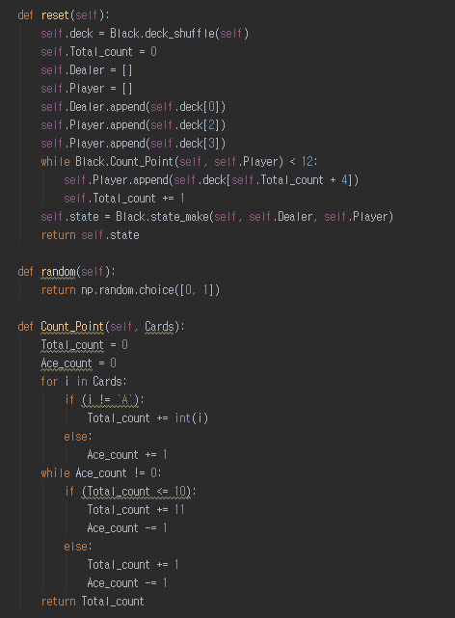
Black-jack
(Code –
env)

Slide 3
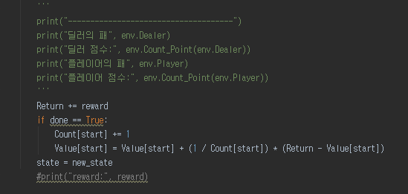
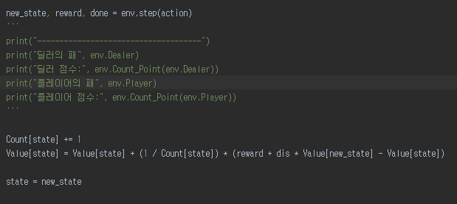
Black-jack
(Code –
Main)
MC:
V(St) ← V(St) + α (Gt − V(St))
TD:
V(St) ← V(St) + α (Rt+1 + γV(St+1) − V(St))
Γ(discount) = 1

Slide 4
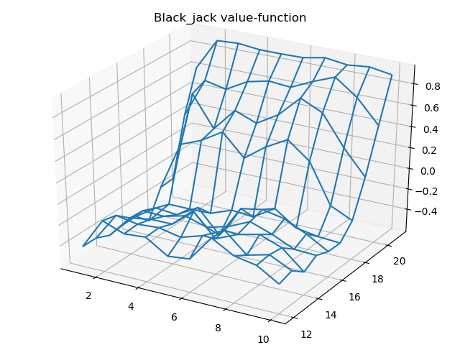
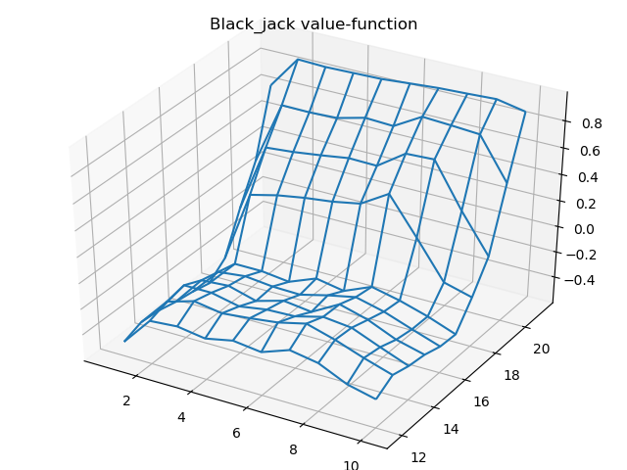
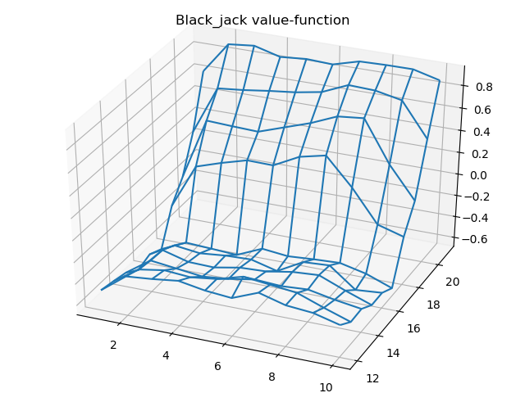
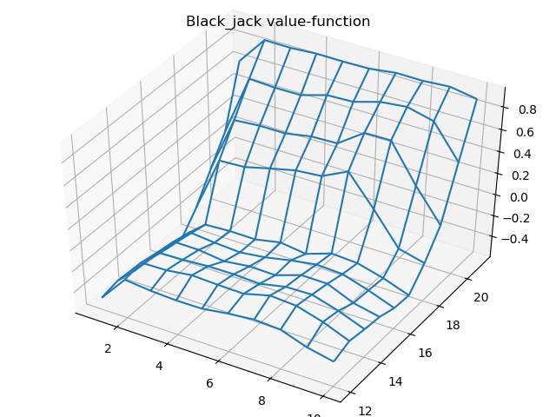
Black-jack
(Result)
Episode : 50,000, discount = 1.0
Episode : 1,000,000, discount = 1.0
Player
Usable
Ace
Player
No-Usable
Ace

Slide 5
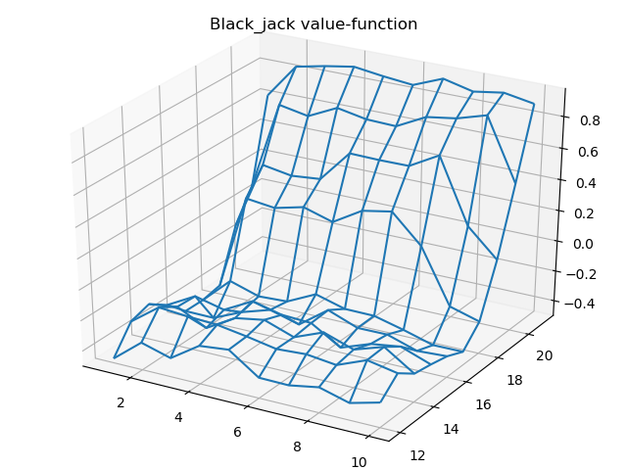
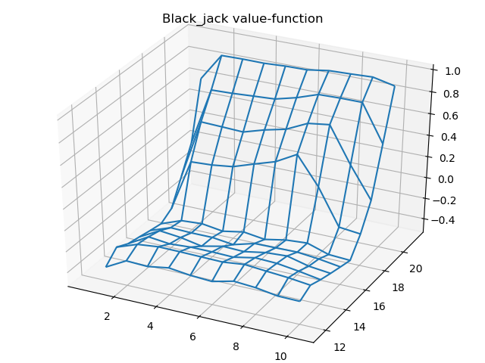
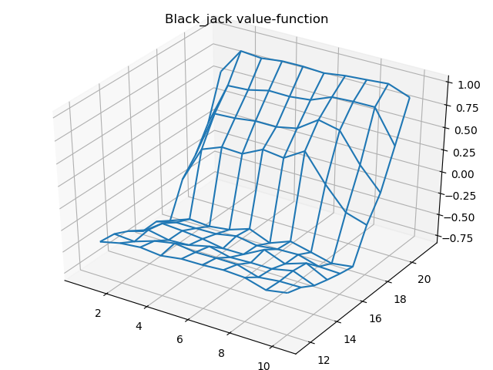
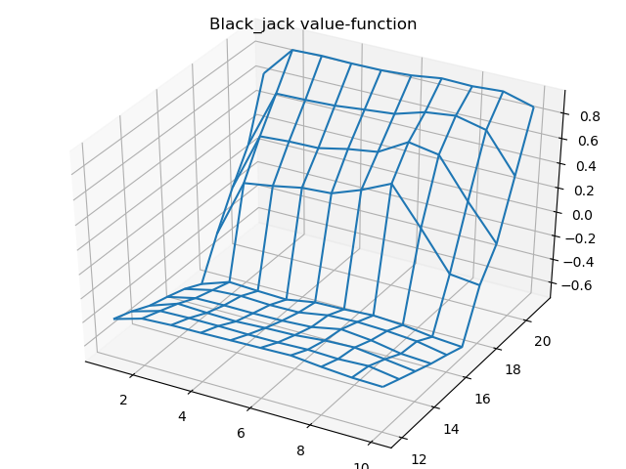
Black-jack
(Result)
Episode : 50,000, discount = 0.5
Episode : 1,000,000, discount = 0.5
Player
Usable
Ace
Player
No-Usable
Ace

Slide 6
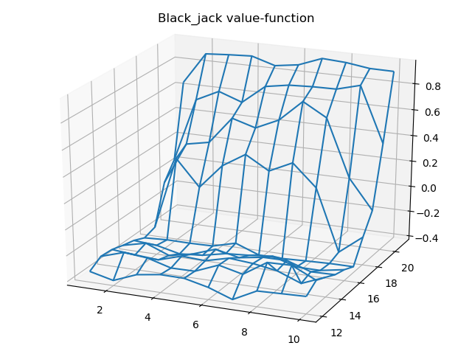
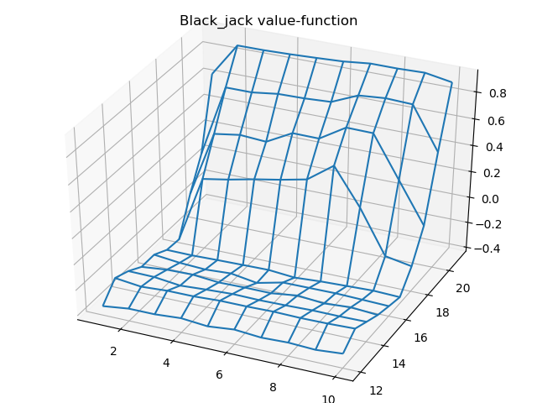
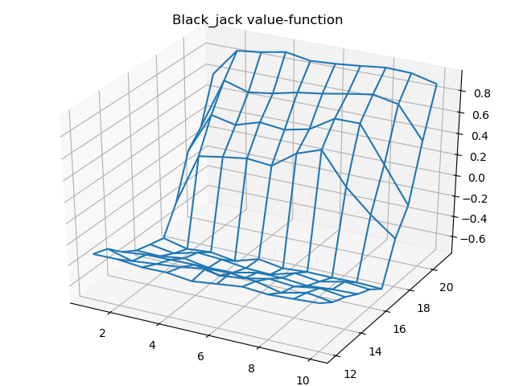
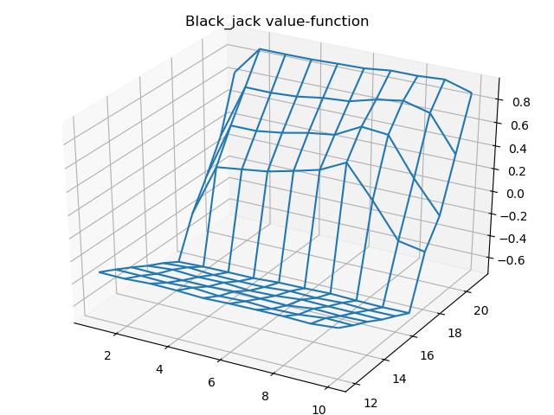
Black-jack
(Code –
Main)
Episode : 50,000, discount = 0
Episode : 1,000,000, discount = 0
Player
Usable
Ace
Player
No-Usable
Ace

